Slide 1
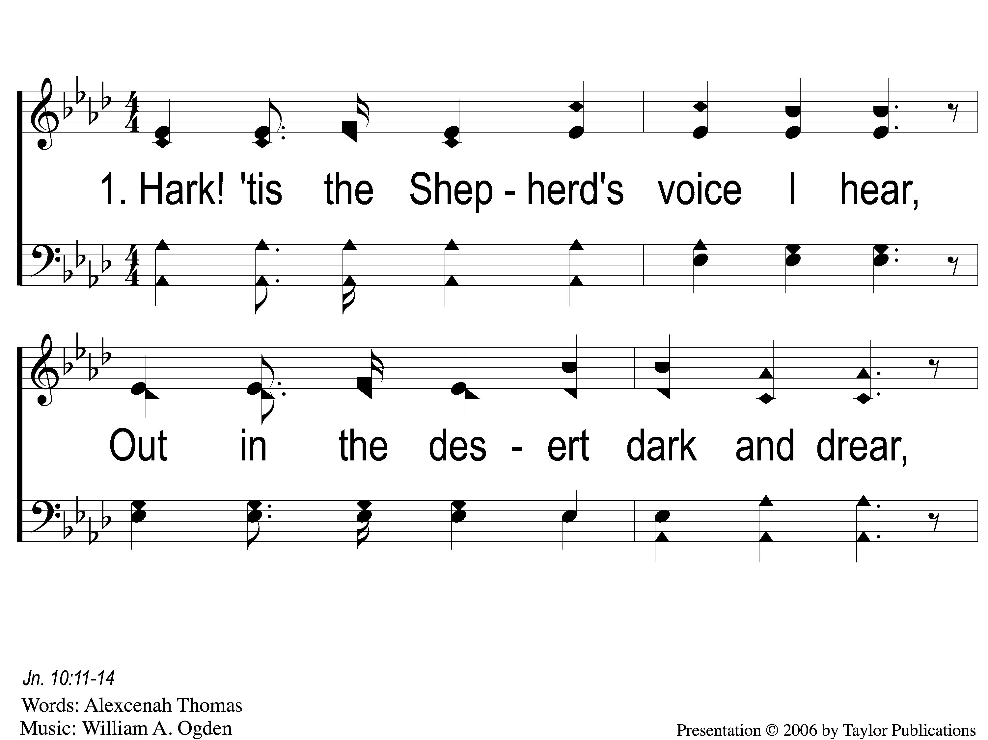
1-1 Hark Tis the Shepherd’s Voice
Hark! Tis the Shepherd’s Voice
165

Slide 2
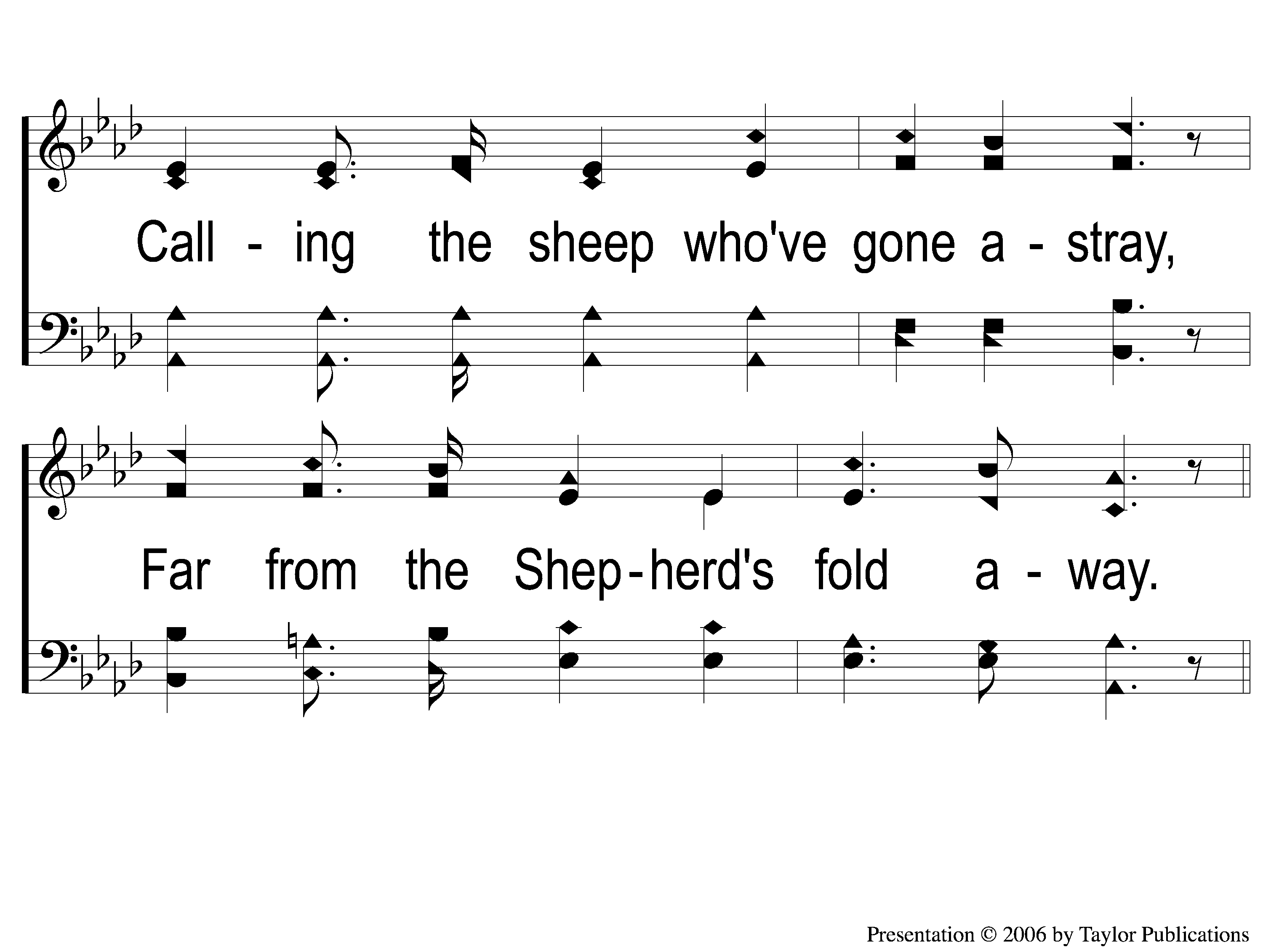
1-2 Hark Tis the Shepherd’s Voice
Hark! Tis the Shepherd’s Voice
165

Slide 3
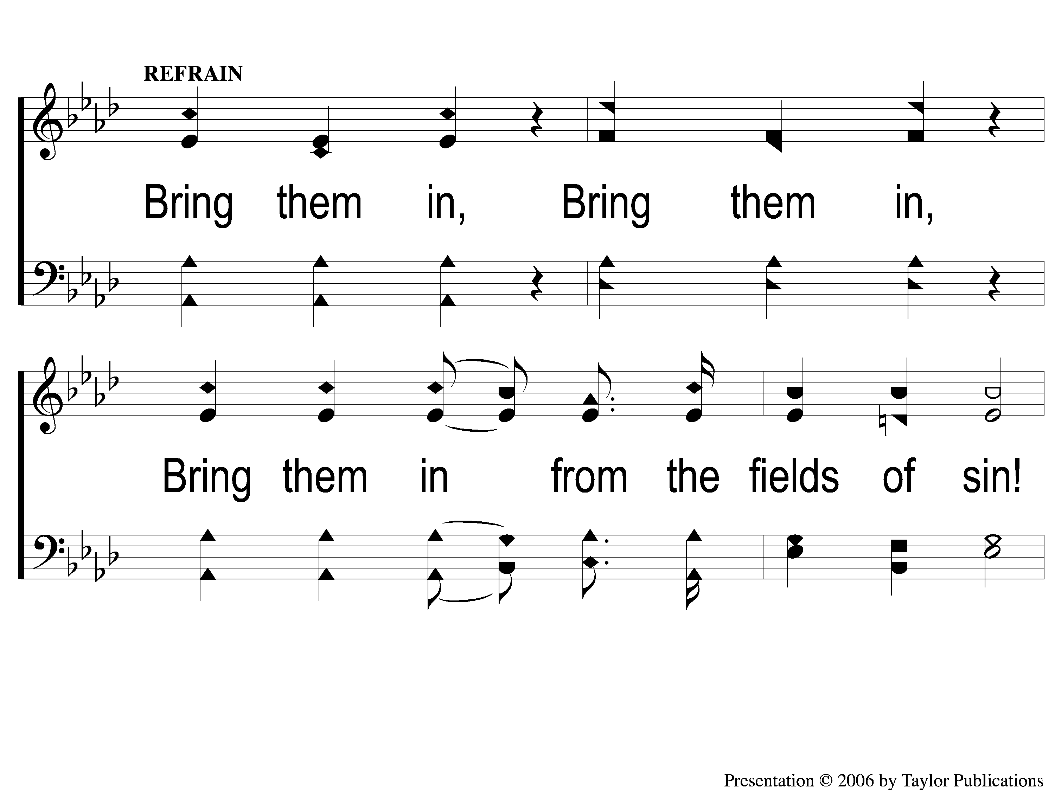
C-1 Hark Tis the Shepherd’s Voice
Hark! Tis the Shepherd’s Voice
165

Slide 4
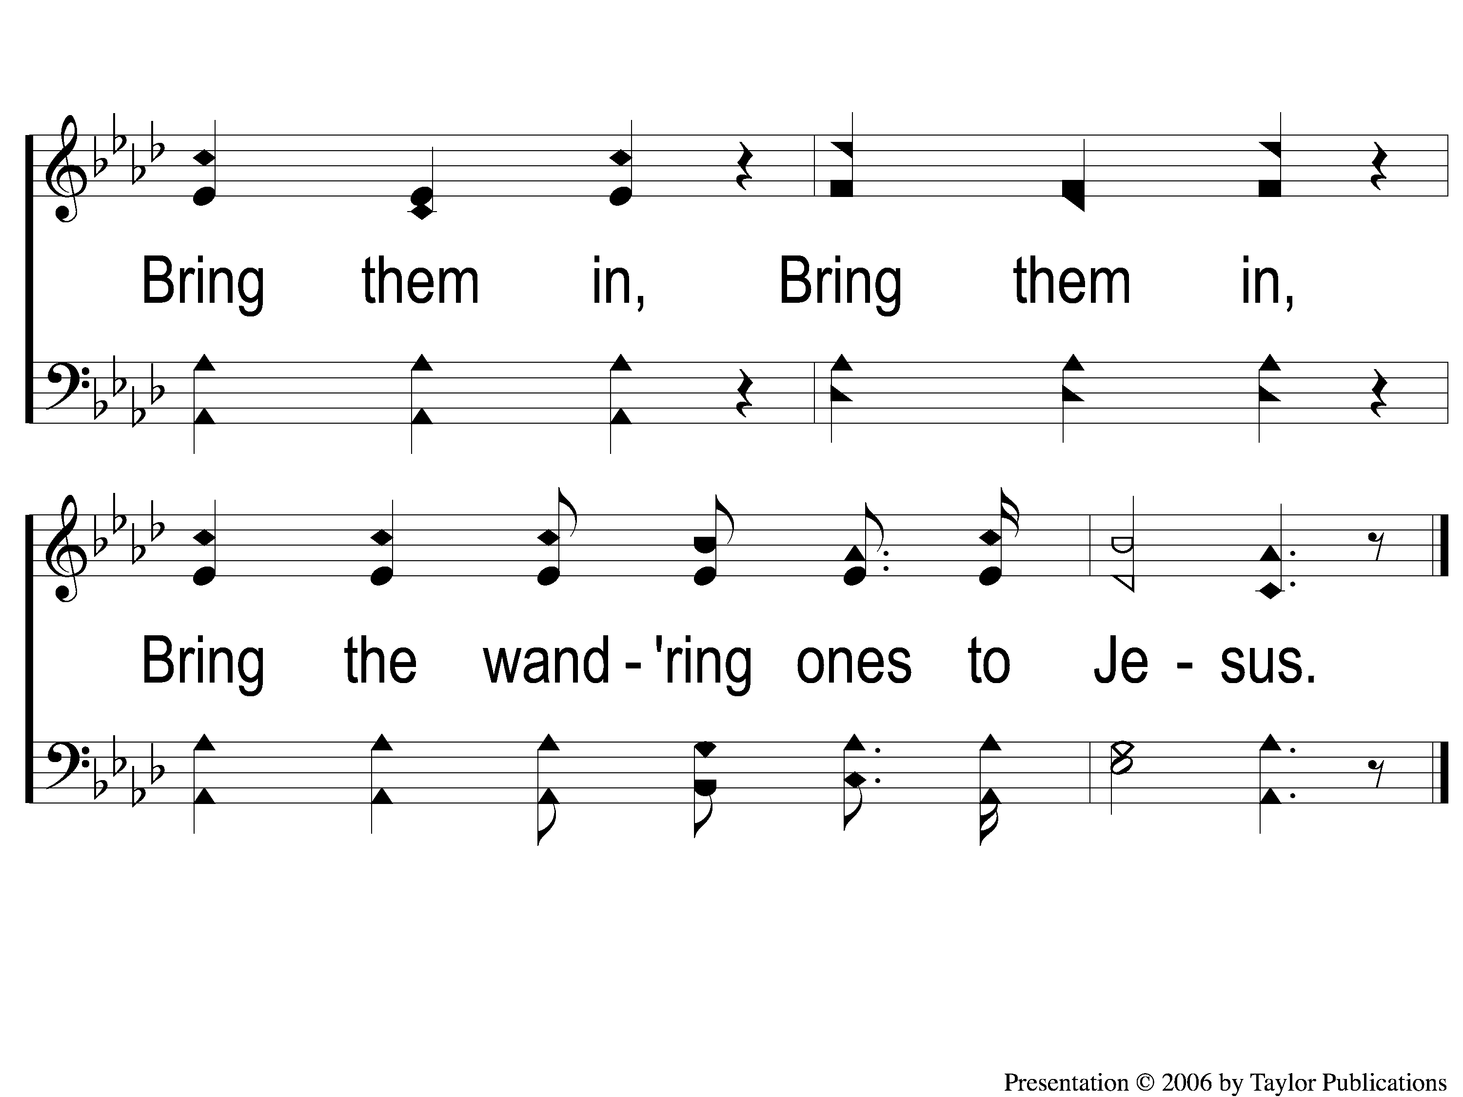
C-2 Hark Tis the Shepherd’s Voice
Hark! Tis the Shepherd’s Voice
165

Slide 5
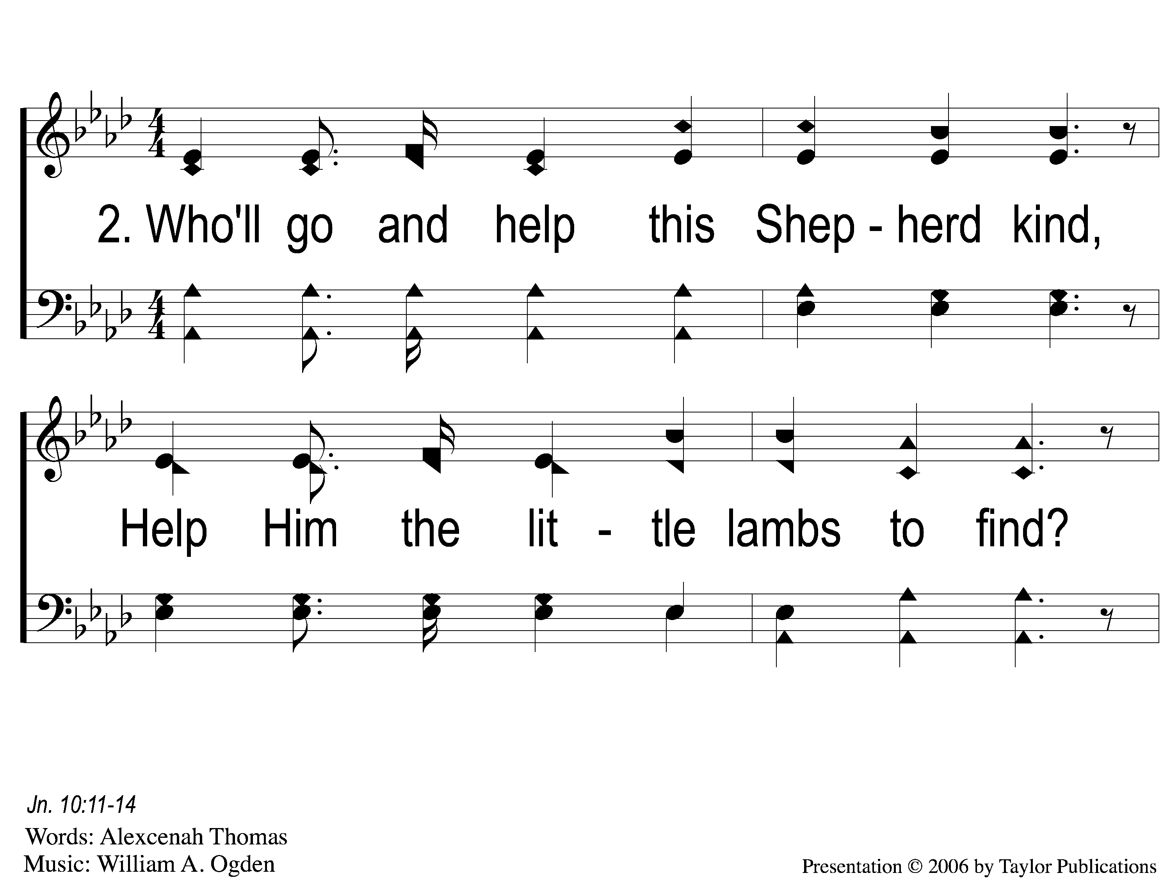
2-1 Hark Tis the Shepherd’s Voice
Hark! Tis the Shepherd’s Voice
165

Slide 6
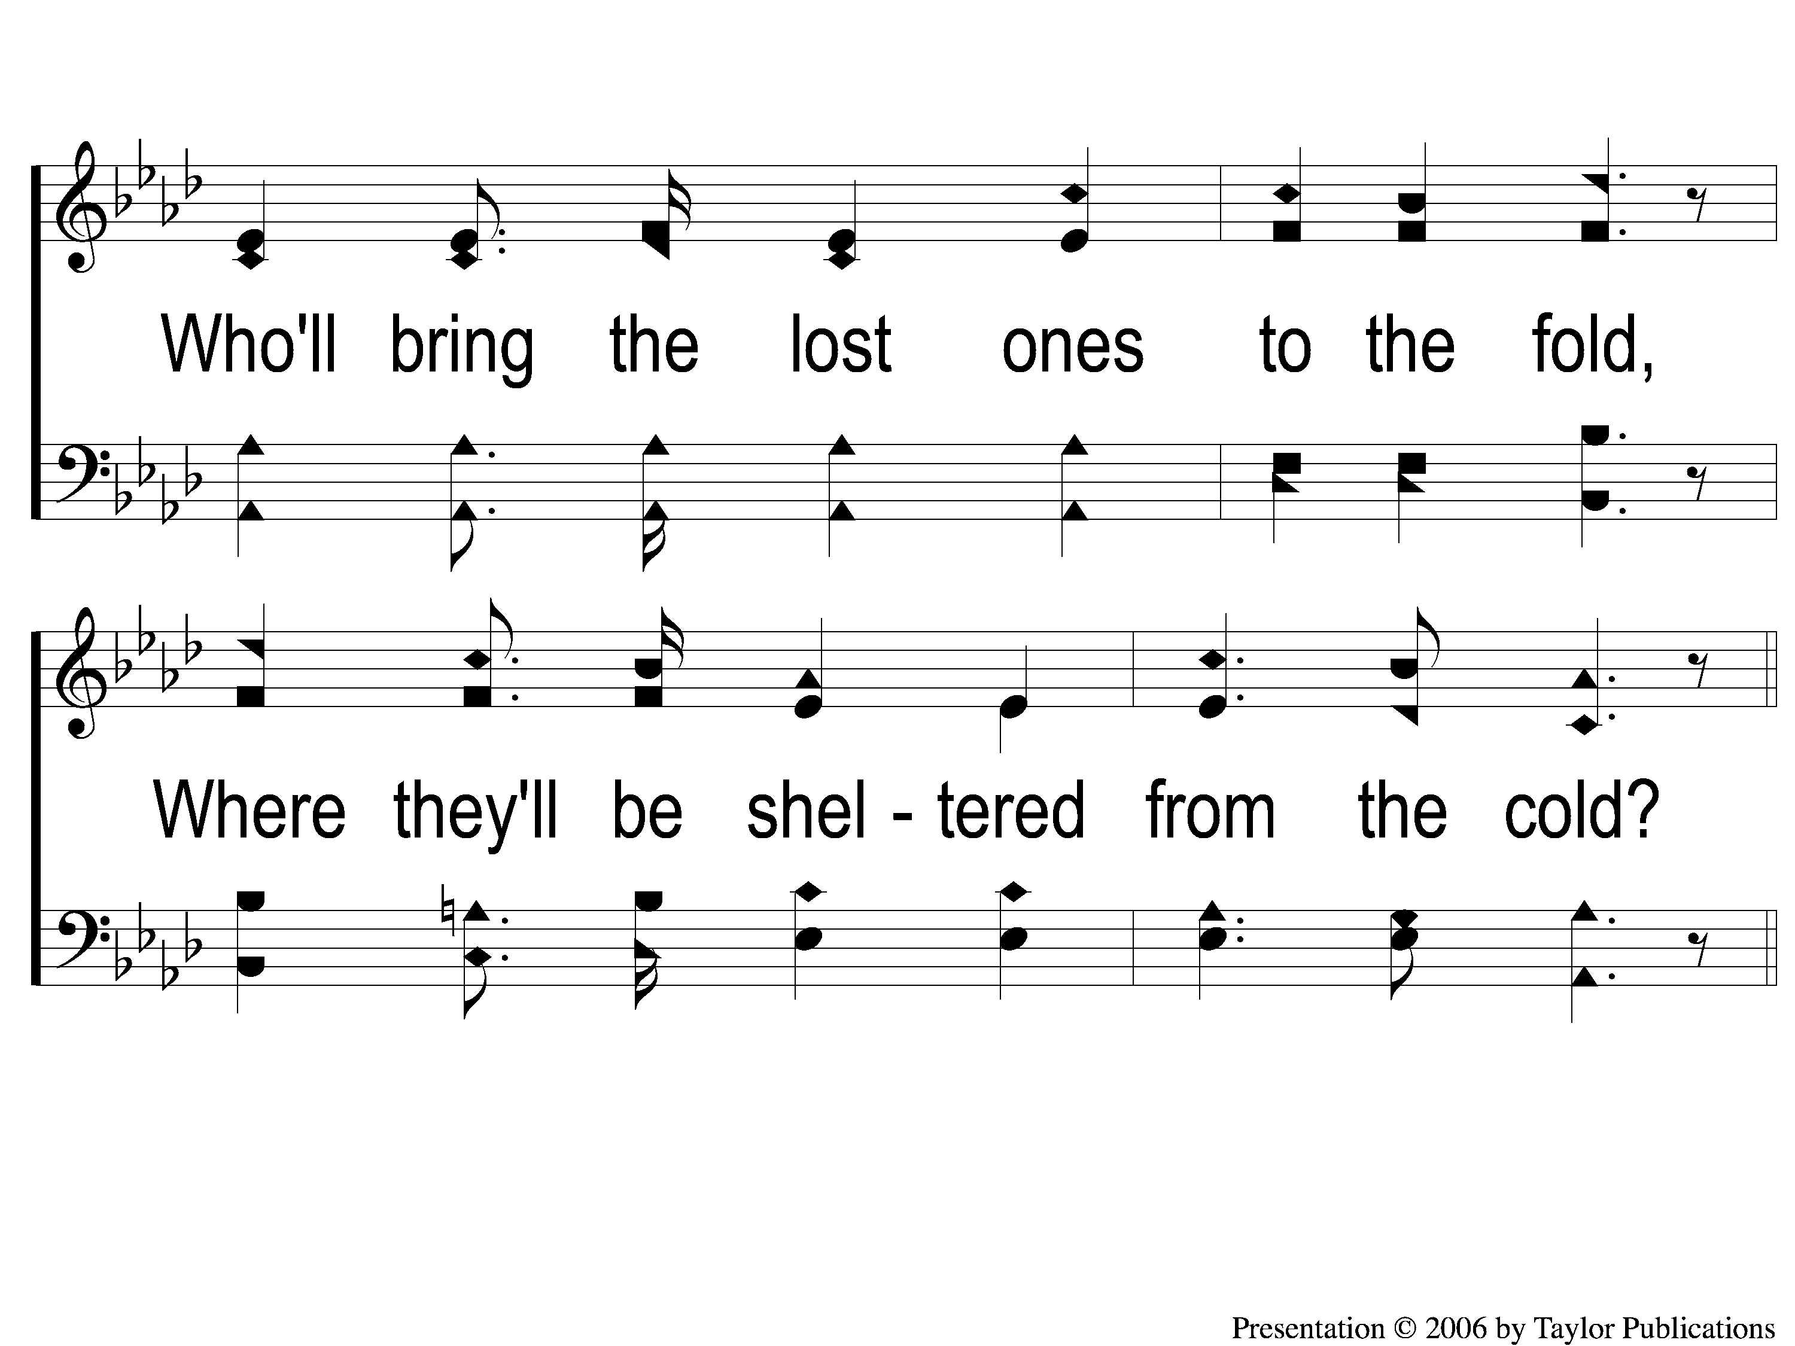
2-2 Hark Tis the Shepherd’s Voice
Hark! Tis the Shepherd’s Voice
165

Slide 7
C-1 Hark Tis the Shepherd’s Voice
Hark! Tis the Shepherd’s Voice
165

Slide 8
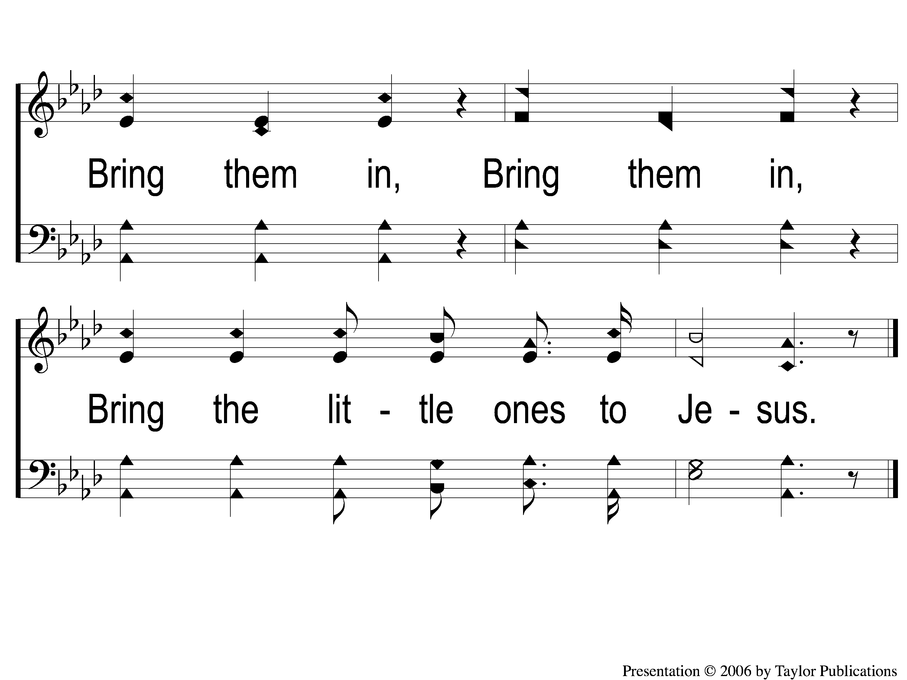
C-2 Hark Tis the Shepherd’s Voice
Hark! Tis the Shepherd’s Voice
165

Slide 9
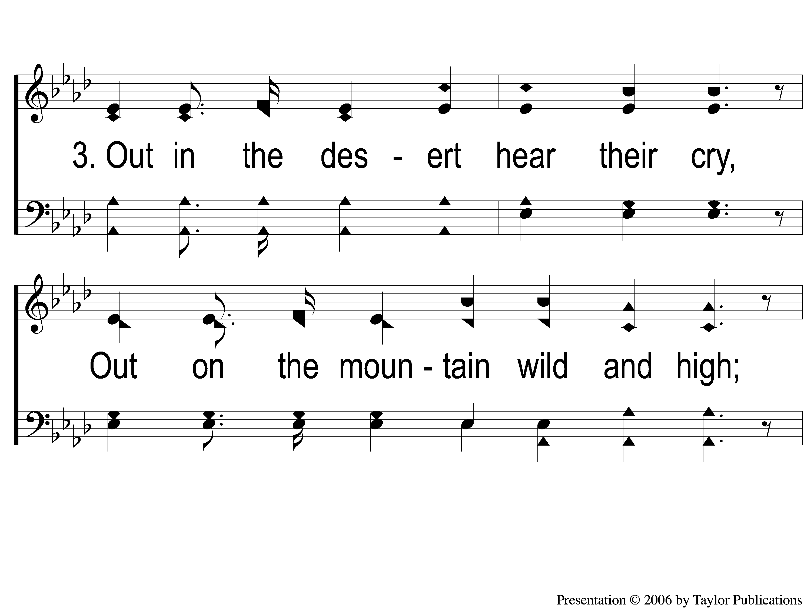
3-1 Hark Tis the Shepherd’s Voice
Hark! Tis the Shepherd’s Voice
165

Slide 10
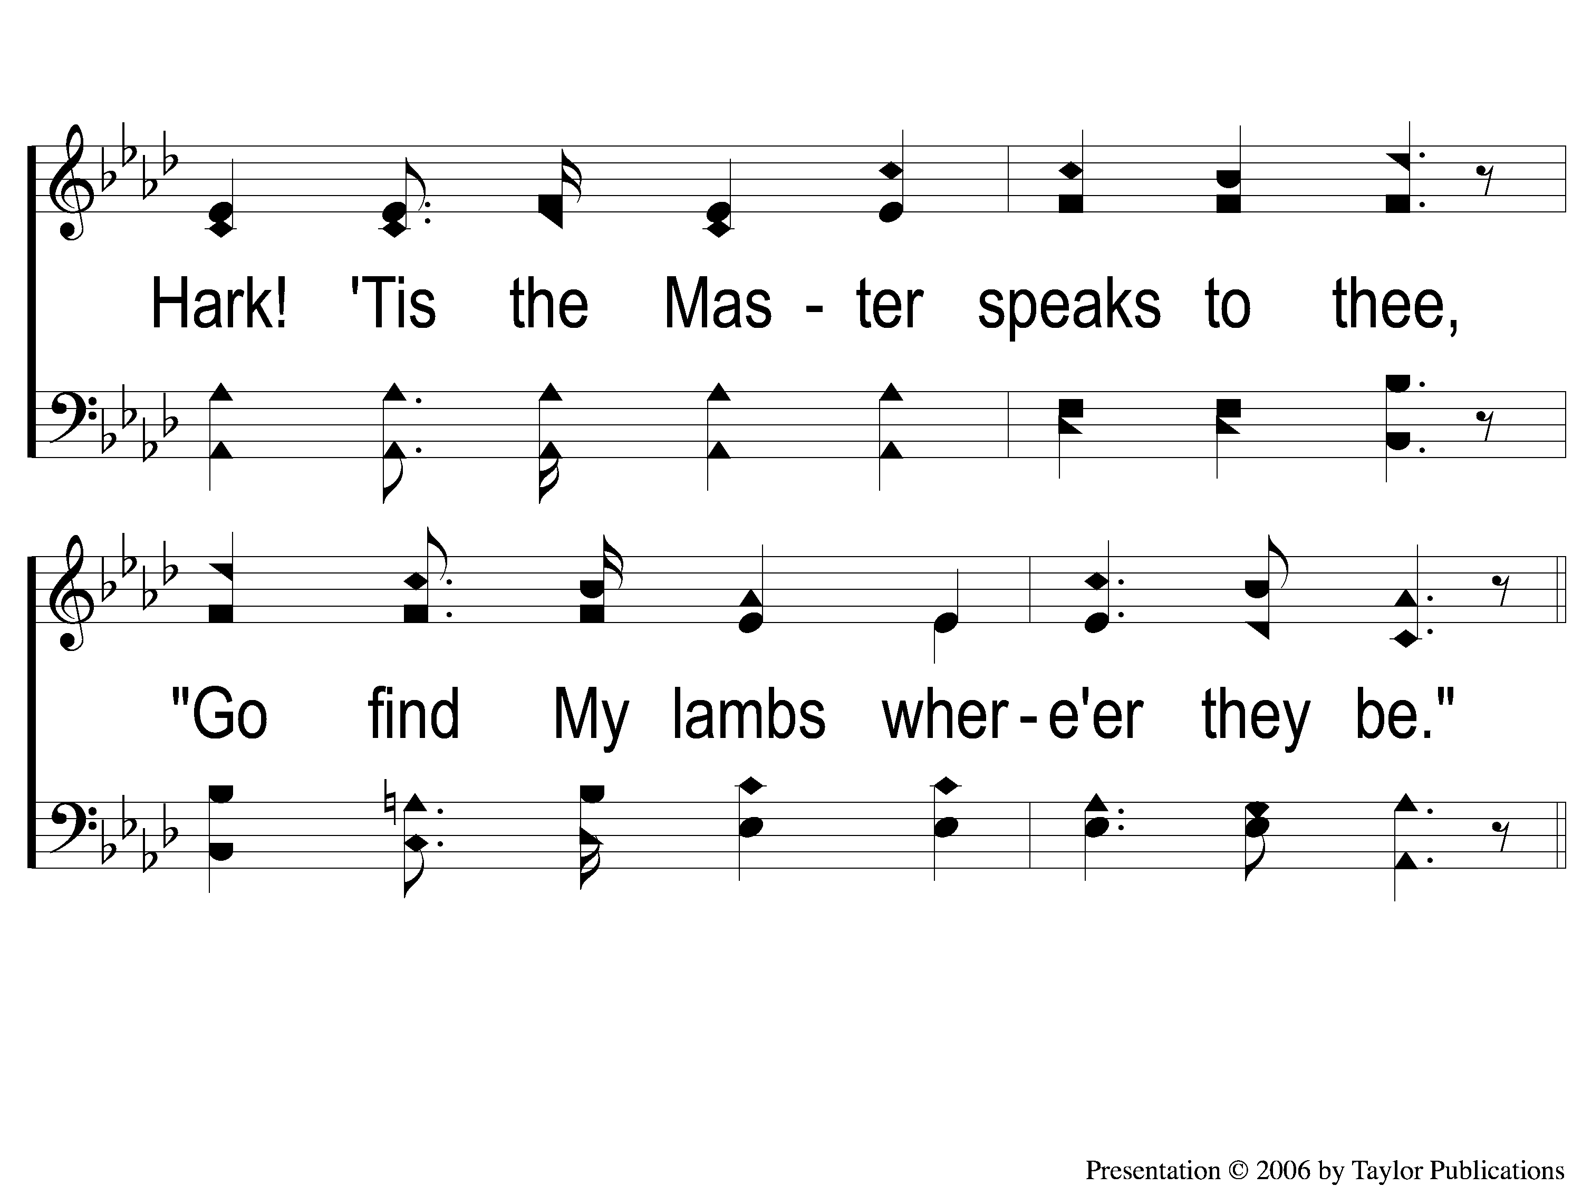
3-2 Hark Tis the Shepherd’s Voice
Hark! Tis the Shepherd’s Voice
165

Slide 11
C-1 Hark Tis the Shepherd’s Voice
Hark! Tis the Shepherd’s Voice
165

Slide 12
C-2 Hark Tis the Shepherd’s Voice
Hark! Tis the Shepherd’s Voice
165

